Slide 1




Heart comorbidity correlates with lung toxicity after (chemo)radiotherapy
Georgi Nalbantov, 2013

Slide 2
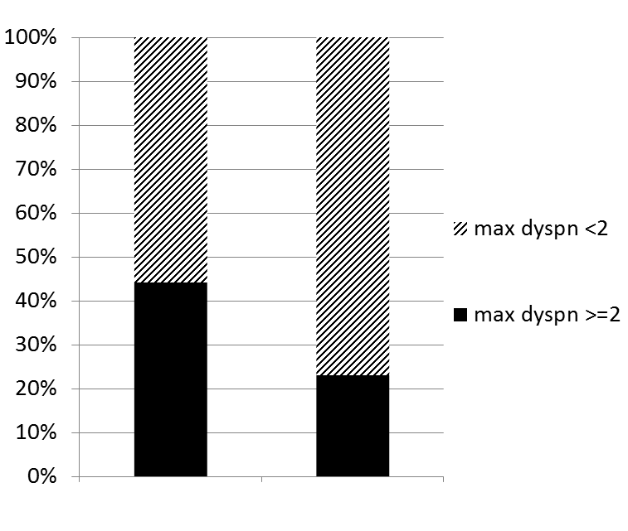
Results: cardiac comorbidity and dyspnea ≥ 2 are correlated
259 patients, training dataset
Patients from azM Maastricht and Atrium Heerlen (The Netherlands)
WITH cardiac comorbidity:
77 patients (30% of all)
43
WITH max dyspnea >=2:
76 patients (29% of all)
140
% patients per group
Odds ratio = (34/43) / (42/140) = 2.6
P-value = 0.0006
34
42
With cardiac
comorbidity
No cardiac comorbidity
Nalbantov et al, 2013 (Radiotherapy and Oncology)

Slide 3
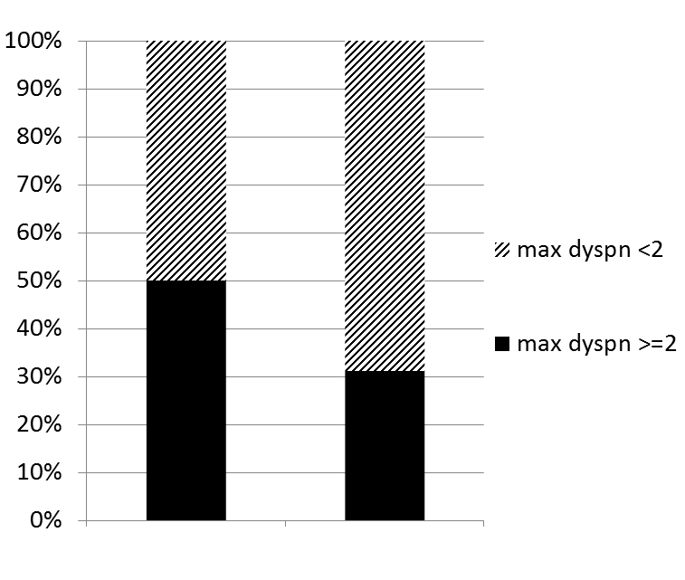
Results: cardiac comorbidity and dyspnea ≥ 2 are correlated
185 patients, validation set
107 patients from UZ Gent (Belgium) and 78 from Univ. Medical Center Nijmegen (Netherlands)
WITH cardiac comorbidity:
34 patients (18% of all)
17
WITH max dyspnea >=2:
76 patients (34% of all)
104
% patients per group
Odds ratio = (17/17) / (47/104) = 2.2
P-value = 0.037
17
47
With cardiac
comorbidity
No cardiac comorbidity
Nalbantov et al, 2013 (Radiotherapy and Oncology)

Slide 4
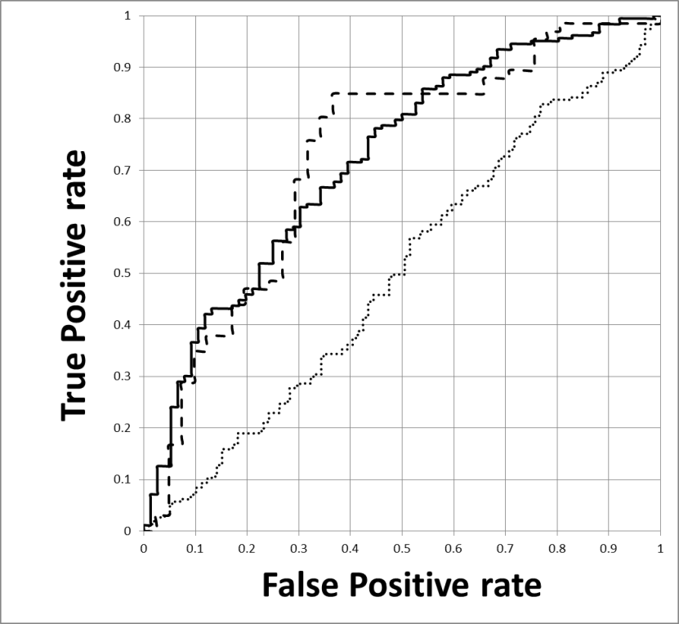
Results: Multivariate analysis
Variable selection method: the Wrapper approach
Input variable | Coeff. | S.E. | p-value | Odds ratio (95% CI)
Cardiac comorbidity | 1.740 | 0.536 | 0.001 | 5.697 (1.993-16.28)
Pre-treatment dyspnea score | 1.009 | 0.425 | 0.018 | 2.744 (1.192-6.314)
Lung Volume | -0.0004 | 0.0003 | 0.137 | 1 (0.999-1.000)
Tumour location (lower/upper lobe) | -0.591 | 0.543 | 0.276 | 0.554 (0.191-1.604)
FEV1 (in %) | -0.011 | 0.013 | 0.396 | 0.989 (0.963-1.015)
Output
Dyspnea grade >=2 between 1-6 months after treatment
Training set (n=259):
AUC = 0.722
Validation set (n=107):
AUC = 0.727
MLD-only model (n=366):
AUC = 0.502
Nalbantov et al, 2013 (Radiotherapy and Oncology)

Slide 5
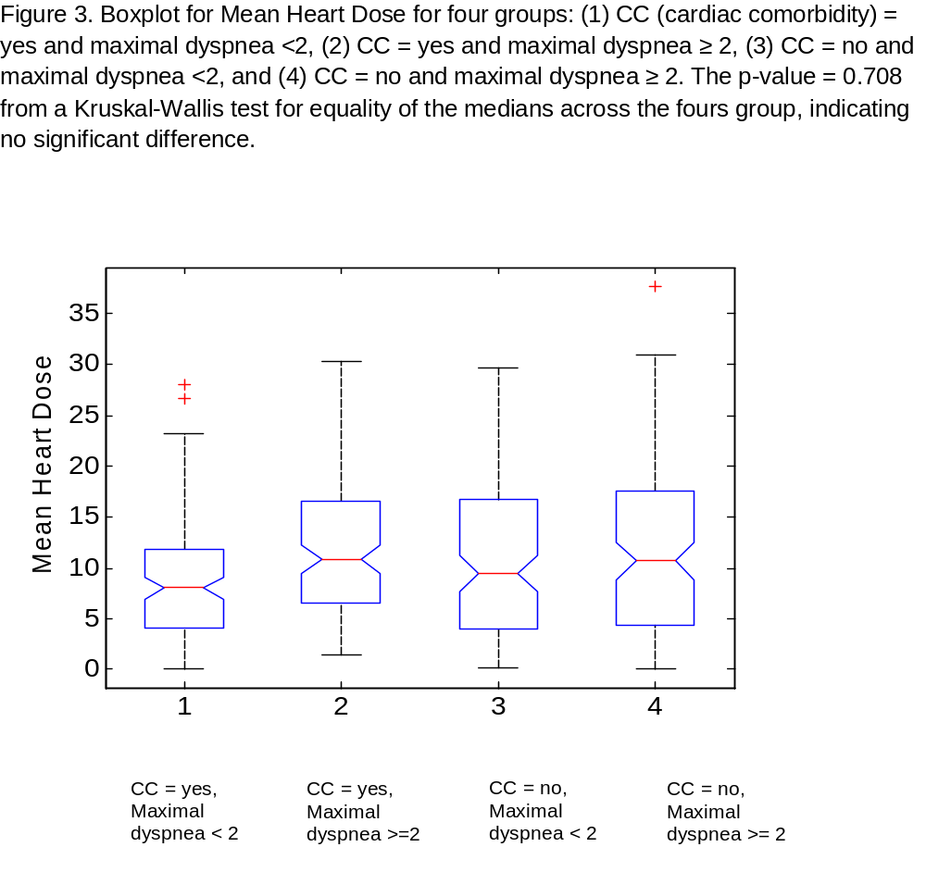
Results: no significant correlation found between heart irradiation and dyspnea ≥ 2
with CC
no CC
n=259 patients, training dataset
Max dyspnea < 2
Max dyspnea ≥ 2
Max dyspnea < 2
Max dyspnea ≥ 2
p-value =
0.708
Box plot
Nalbantov et al, 2013 (Radiotherapy and Oncology)
CC = cardiac comorbidity

